Slide 1
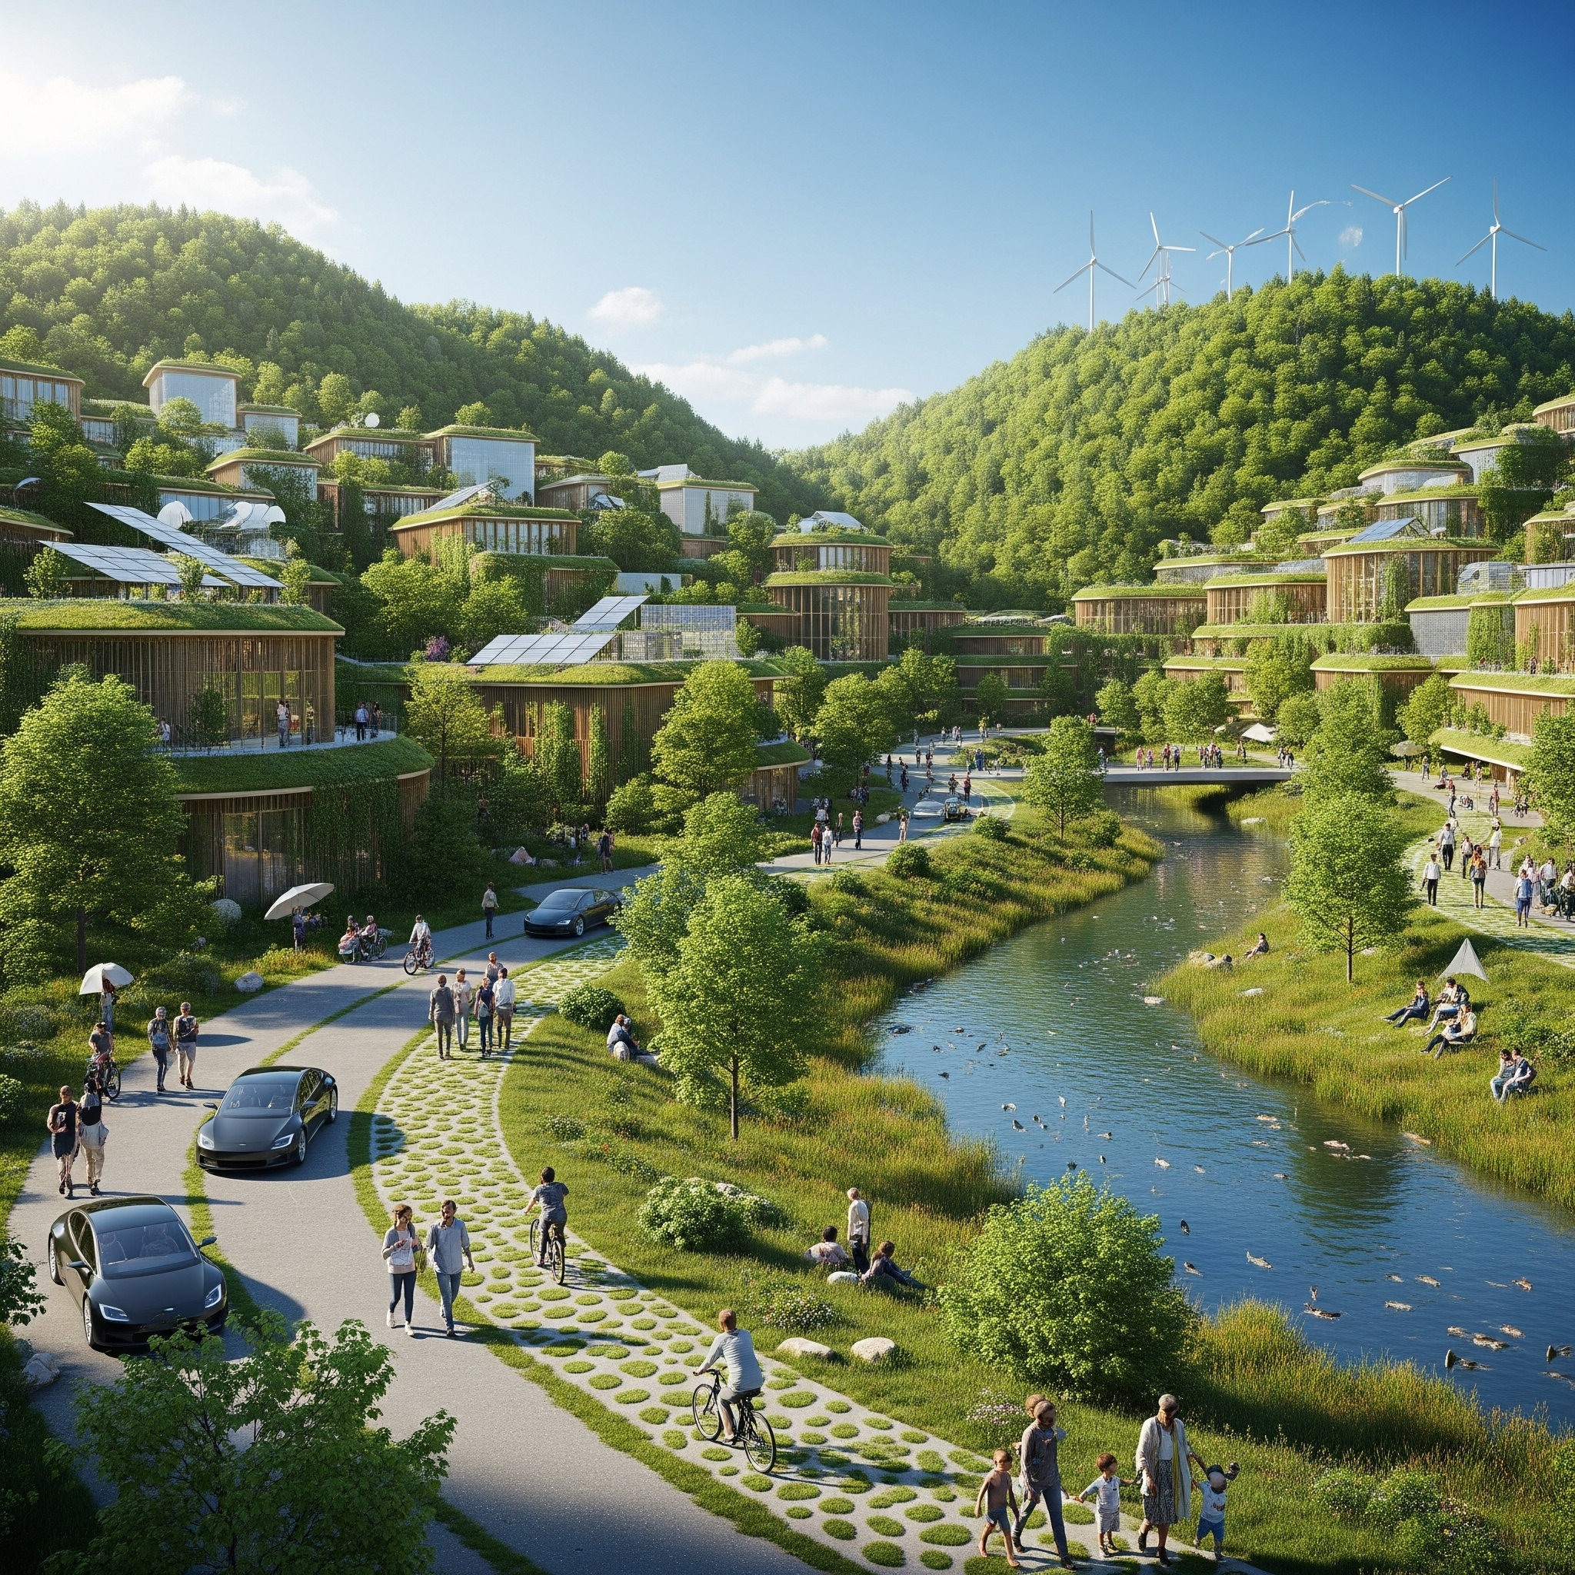
Parking Garage Management System
Course: CS 401-02 Fall 2025
Group 4:
Tuan Do
Matthew Gomez Smith
Christopher Ovando Morales
Kegang Peng
Diego Ruiz Paredes

Slide 2

Project Overview
How it works:
The Driver pulls up to the parking garage. The system will scan the license plate and generates an internal Ticket with license plate and entry time.
The system will save the Ticket and automatically updates the total number of cars in the parking garage.
Driver pulls up at the exit, System will scan their license plate, pull up the internal ticket and calculate the fee.
Driver User Interface will display fee, duration of stay and provide payment options.
Exit gate will open once ticket is paid.
The system will save all the Tickets in txt file.
The system will automatically generate a monthly report and save in txt file for operator to view.

Slide 3
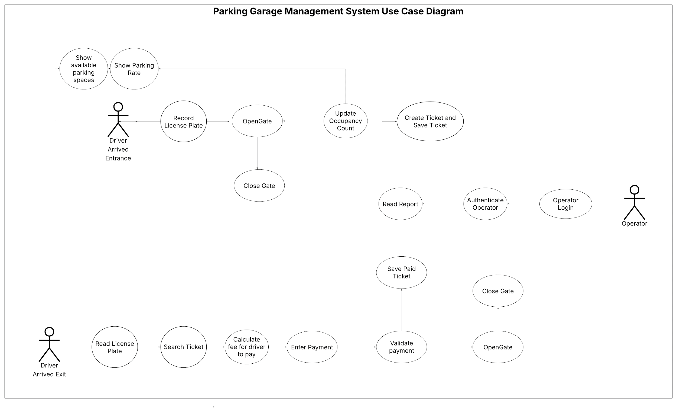

Slide 4
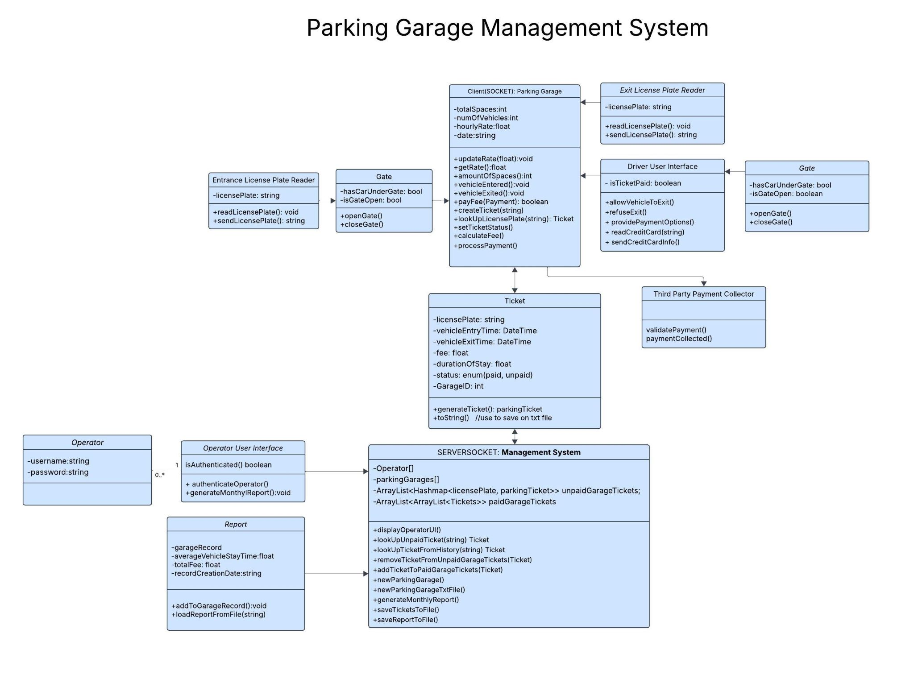
Notes:
This is the overview of the UML class diagram

Slide 5
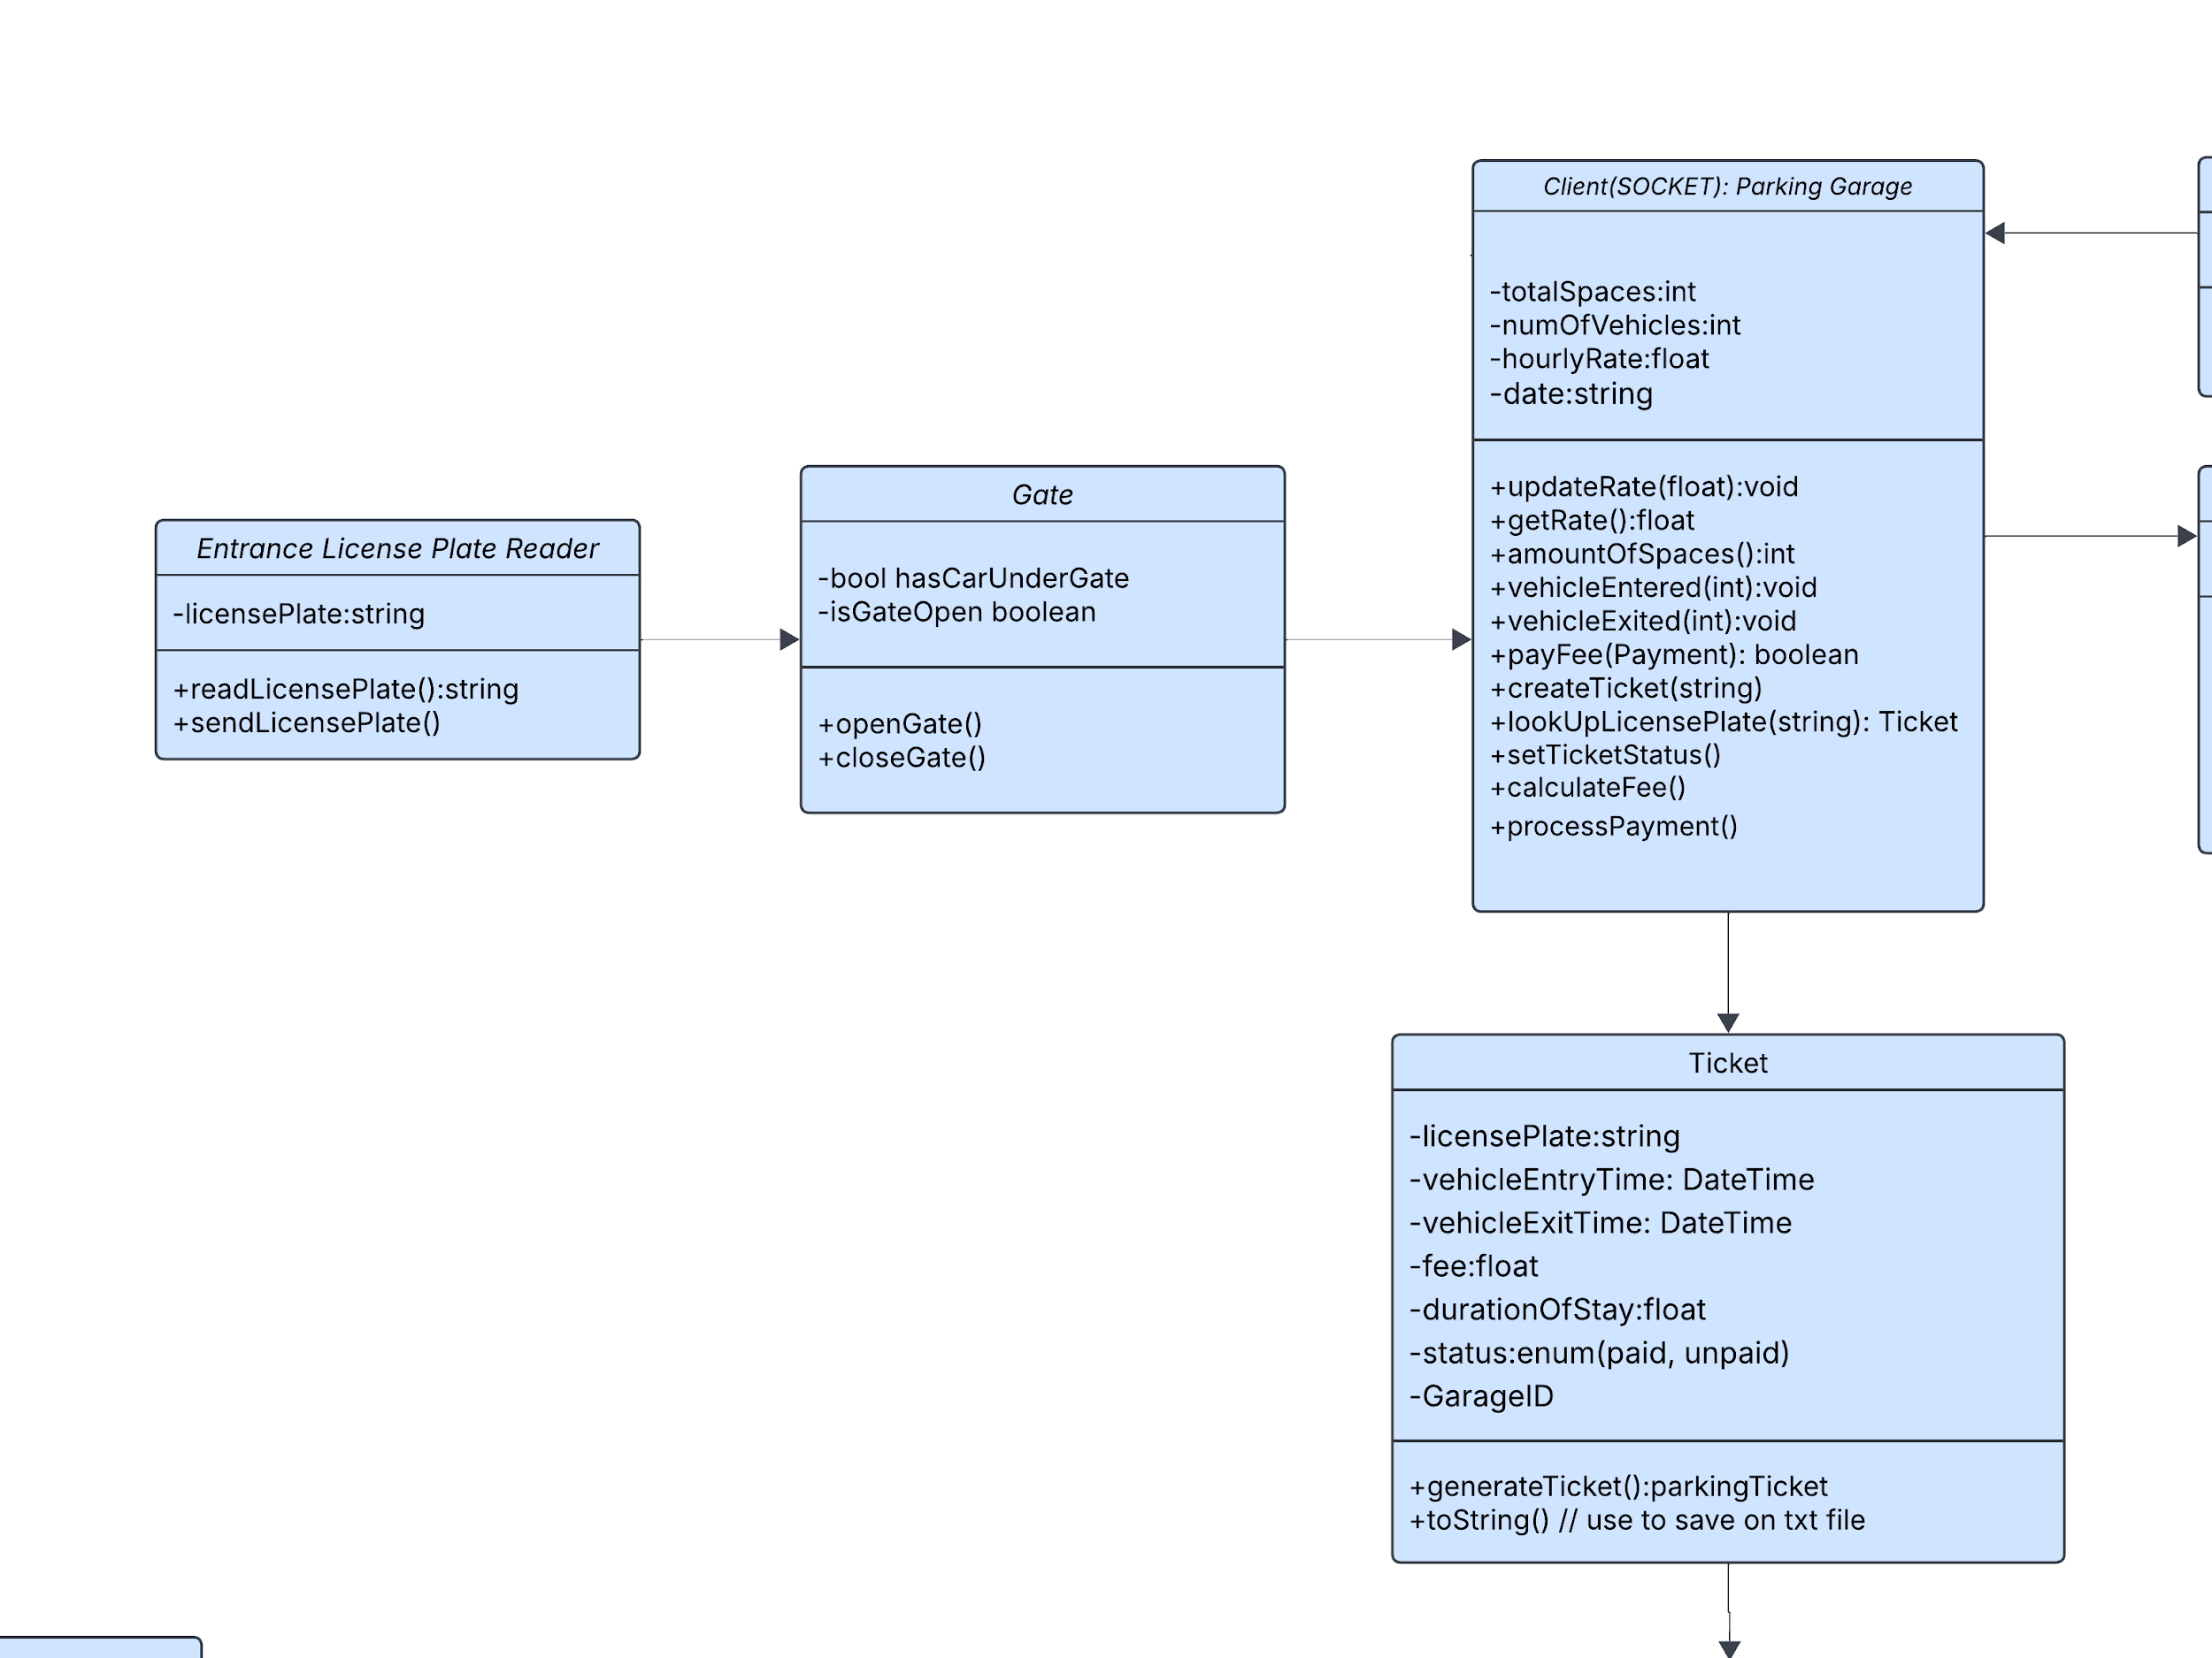
Notes:
This section will cover when the driver arrives at the Garage gate;
The system will read the car license plate;
The system will generate a ticket;
The system will open the gate; Close gate upon driver entering;

Slide 6
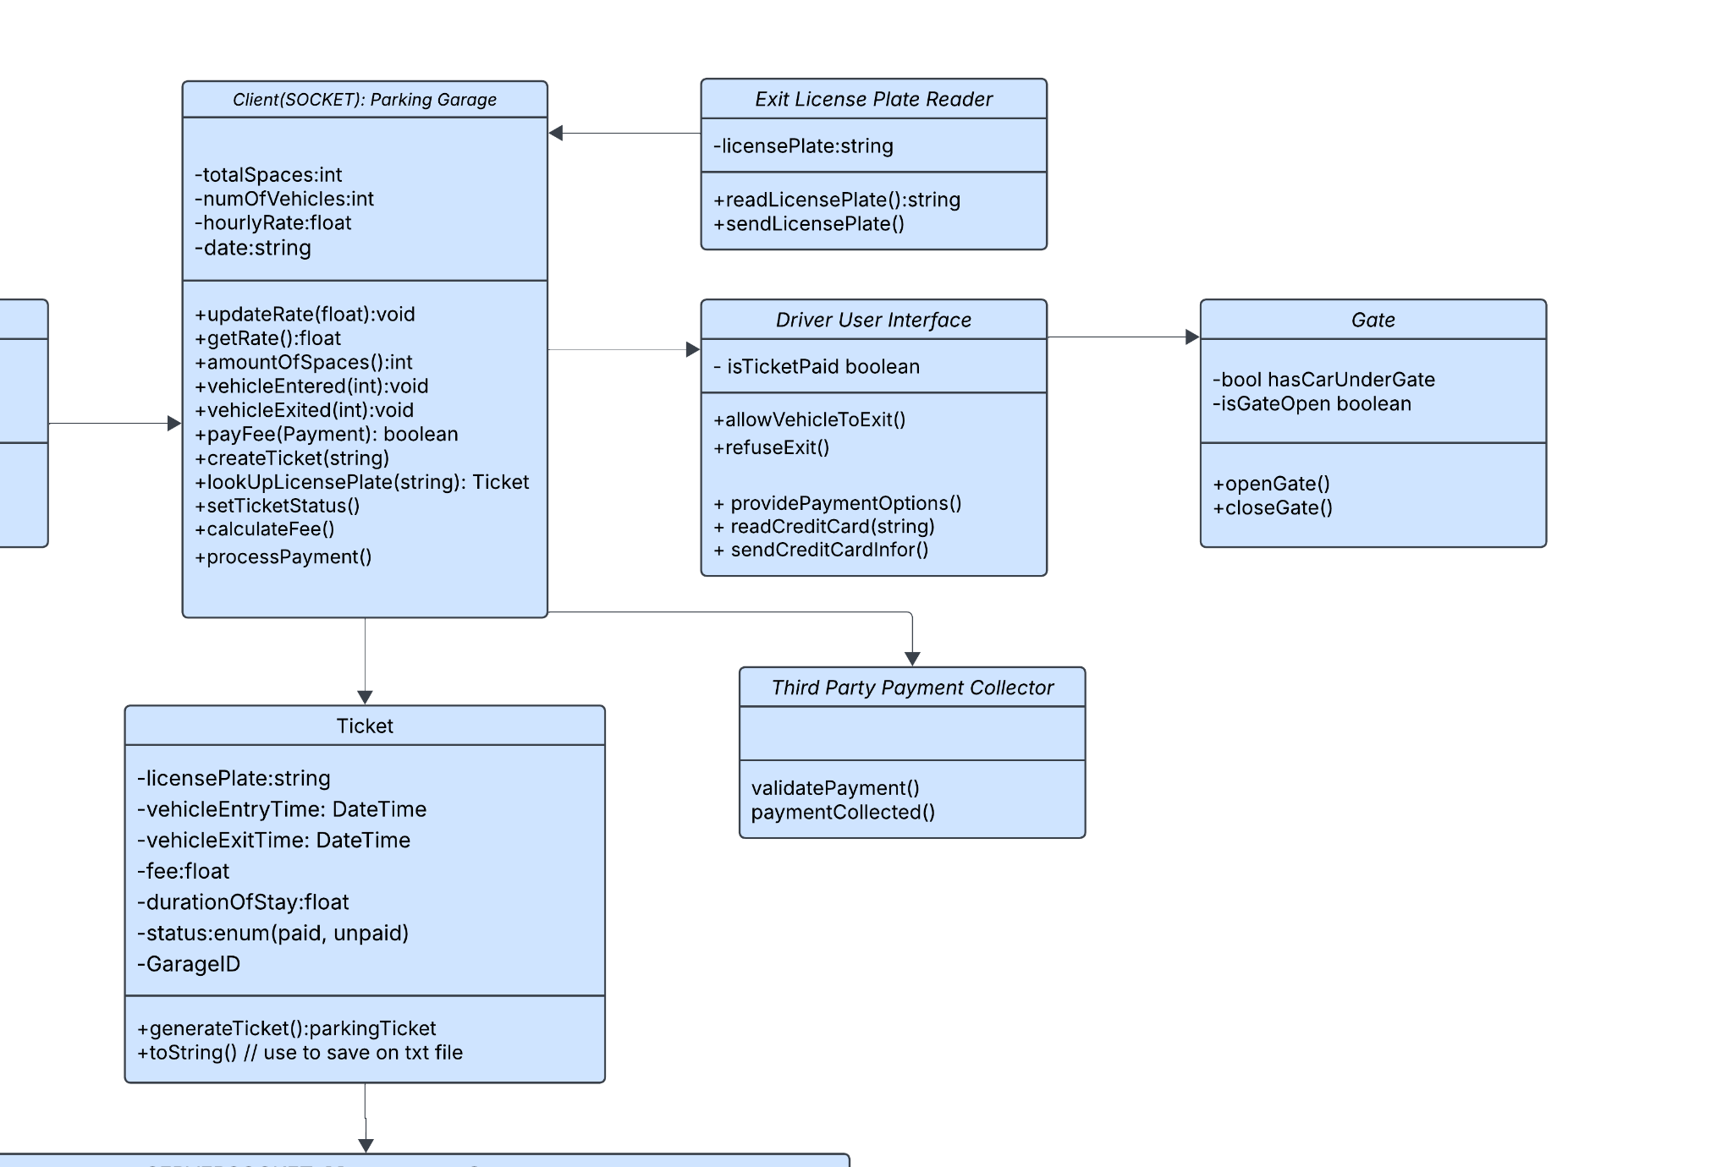
Notes:
This is when the user will leave the Garage;
System will read license plate; Pull up ticket; Calculate Fee; Allow driver to pay amount; Send to Third Party Processor; Open Gate;

Slide 7
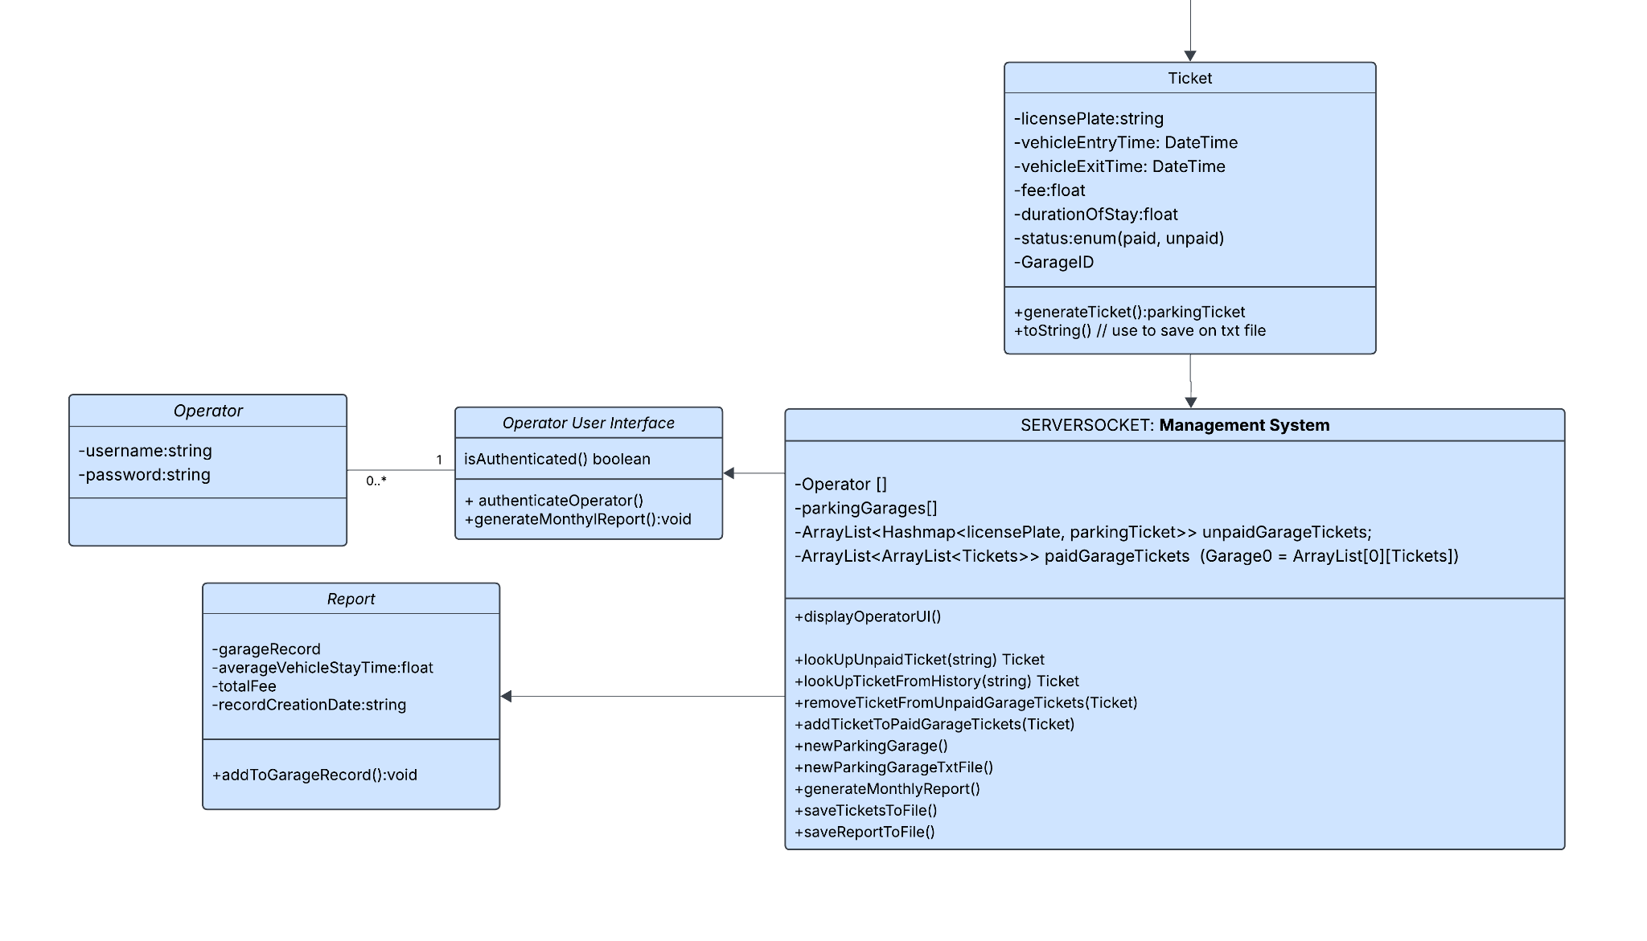
Notes:
This system will reserve tickets, create a monthly report automatically, allow operator to log in and log out, and print the report.
Our “database” will be contained in a text document

Slide 8
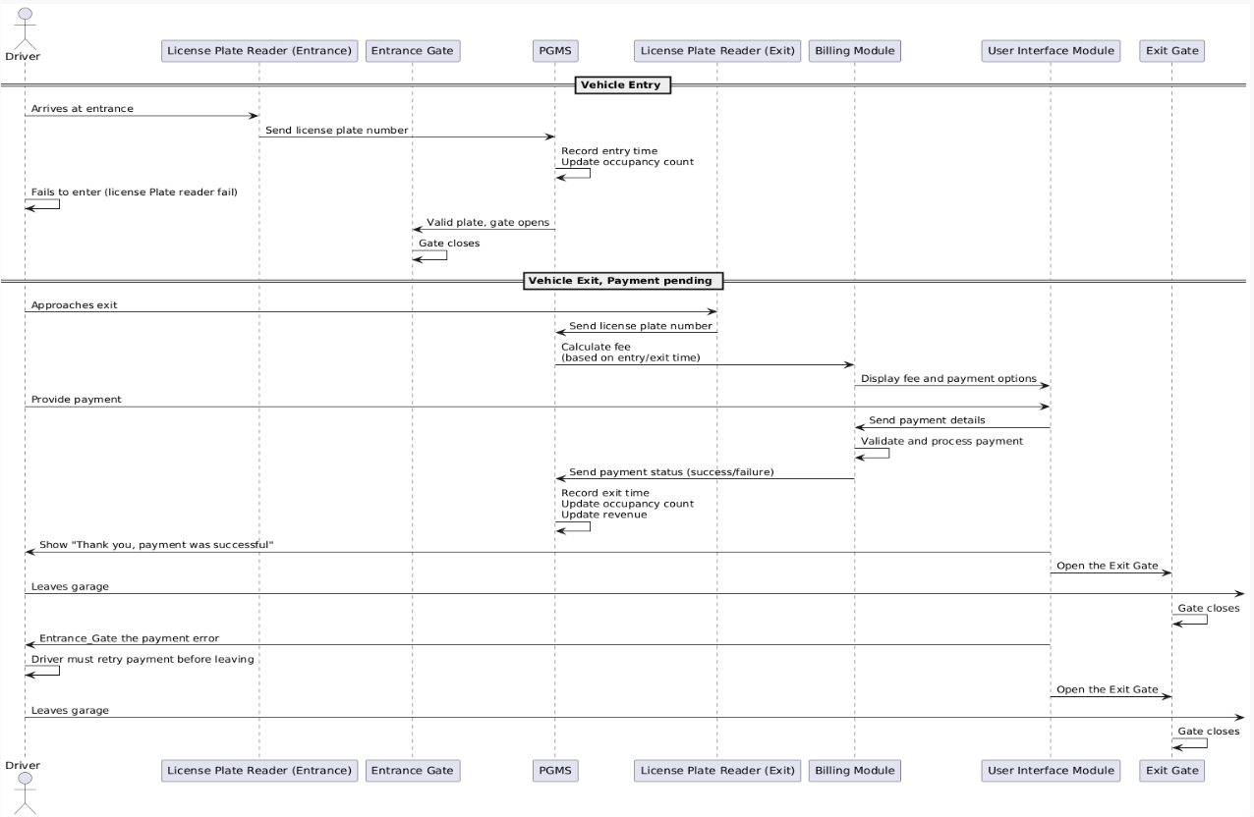

Slide 9
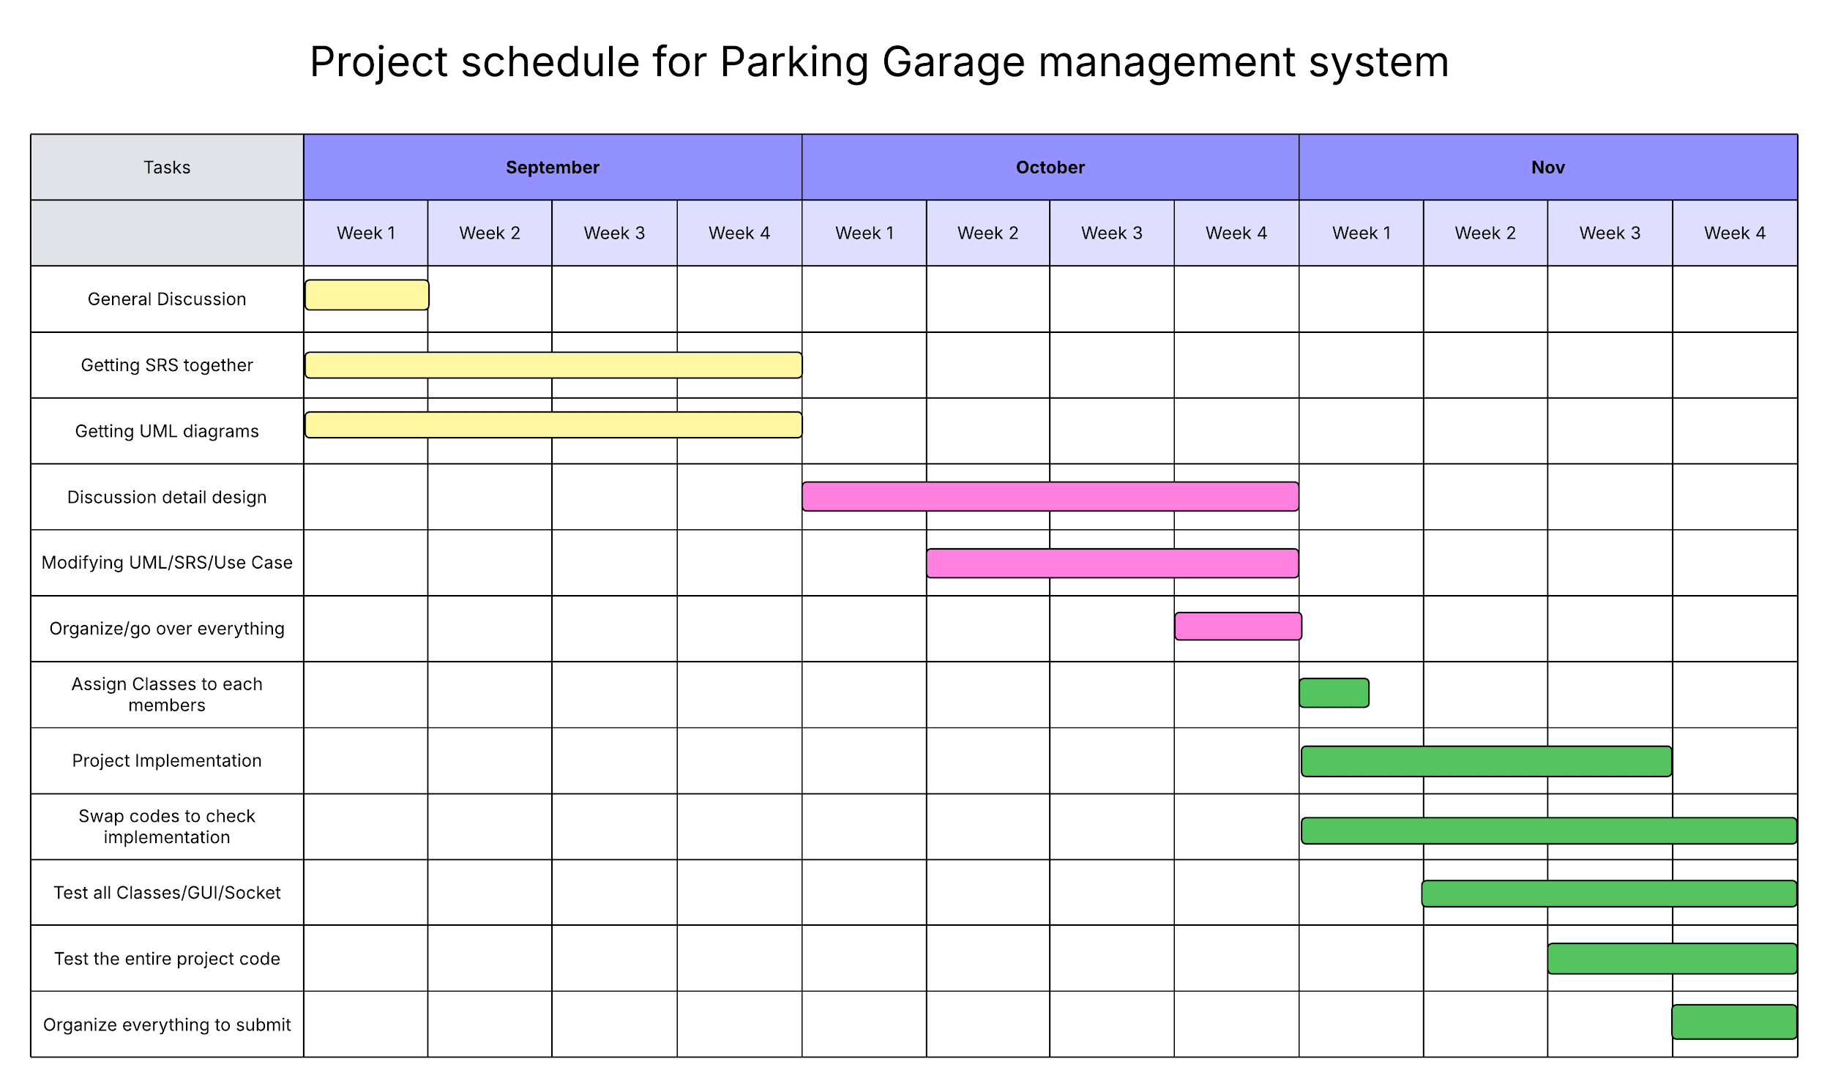

Slide 10

Summary
In conclusion, the Parking Garage Management System design will serve as our guiding blueprint for building the system. It defines the structure of our code and, more importantly, the relationships between its components, ensuring alignment with the requirements and consistency across all modules.
Next Steps: Implementation, Testing and Maintenance Thank you!

